Slide 1

Presentation
“Local RAG Chatbot for customer service”
Presented by Yuliia Herasymenko
Email: gerasymenkojulia2@gmail.com
Notes:
Hello, everyone. My name is Yuliia Herasymenko, and today I’m presenting my Master’s thesis titled:
‘CLIPGraph: A Graph-Based Approach for Contrastive Learning of CLIP Representations.’
I’ll begin by briefly outlining the motivation behind this work, followed by our research goals, methodology, and experimental results, and I’ll end with conclusions and possible future directions.”

Slide 2
Agenda
Introduction & Context
Part 1: Setup & Knowledge Base
  LLM and Embeddings
  Document Ingestion
  Vector Store Architecture
Part 2: RAG Pipeline
  Enhanced Retrieval Pipeline
  Response Generation
Part 3: Demo in Action
Part 4: Tools & Evaluation
Part 5: Conclusion & Outlook
Notes:
Today, we’ll cover the following sections: an introduction, research goals and tasks, related work, the methods which were applied, experiments and evaluation metrics, quantitative results as well as (with) visualizations for easier interpretation, and finally, the conclusion and outlook.
______
Today we are going through several sections: we cover introduction…talk about research goals and tasks… methods described in this work, Experiments & Metrics we used, look through quantitative results as well as visualizing them in the form of graphs for better interpretability.

Slide 3
Introduction & Context

Slide 4
Introduction & Context
Overview
Problem: Customers frequently ask repetitive questions (vehicle features, service schedules, warranties, ordering, etc.) that are already documented internally.
Goal: build a local RAG-based chatbot for automotive customer support, grounded in an internal knowledge base.
Idea: Implementing a retrieval-augmented chatbot?
  Save agent time
  Speed up answers
  Improve customer satisfaction by providing immediate, accurate responses.
RAG enables LLMs to retrieve relevant, authoritative information from existing documents, keeping answers up-to-date and trustworthy.
Notes:
“Let’s start with a brief overview of CLIP “
lets move on to the key idea
________________________________________________________
We believe CLIP’s text features are underused — and we aim to change that.”

Slide 5
Part 1: Setup & Knowledge Base

Slide 6

Part 1: Setup & Knowledge Base
Vector Store Architecture
Category | Advantages (Pros) | Disadvantages (Cons)
Cost & Setup | Free & Open Source: no monthly “pod” costs (e.g., Pinecone Pricing). | Single-Node Architecture: Difficult to scale horizontally; if you outgrow one server, you must migrate.
Speed | Great for Prototyping: fastest way to build a working demo. | Concurrency Bottleneck: High traffic causes “database is locked” errors due to the SQLite backend.
Performance | Local Storage: All data stays on your machine for maximum privacy. | Memory Dependency: Because of the HNSW algorithm, the entire index must fit in your System RAM.
Scalable Alternatives
Weaviate: Best for enterprise-grade scalability due to Horizontal Sharding, Hybrid Search and Smart Filtering support.
FAISS: Best for maximum raw search speed due to GPU support and advanced search algorithms, e.g. Inverted File (IVF).
Notes:
Concurrency Bottleneck: High traffic causes “database is locked” errors due to the SQLite backend, which limits concurrent write access.
"Unlike Chroma, which is limited by the storage of a single machine, Weaviate allows us to link multiple servers together. If our knowledge base grows, we don't buy a bigger computer; we just plug in another small one."
Free & Open Source
No monthly “pod” costs (e.g., Pinecone).
Great for Prototyping
Fastest way to build a working demo.
Local Storage
All data stays on your machine for maximum privacy.
Concurrency Bottleneck
High concurrency can cause slower responses or “database is locked” errors.
Root cause: SQLite backend limits concurrent write access.
HNSW Indexing: Uses the Hierarchical Navigable Small World algorithm, which allows for lightning-fast similarity searches by keeping data in a specific "graph" structure.
Single-Node Design: Unlike enterprise systems, it runs on a single machine. It does not support native sharding (splitting data across multiple servers).
Category Advantages (Pros) Disadvantages (Cons)
Cost & Setup Free & Open Source: No monthly “pod” costs (e.g., Pinecone Pricing). Single-Node Architecture: Difficult to scale horizontally; if you outgrow one server, you must migrate.
Speed Great for Prototyping: Fastest way to build a working demo. Concurrency Bottleneck: High traffic causes “database is locked” errors due to the SQLite backend.
Performance Local Storage: All data stays on your machine for maximum privacy. Memory Dependency: Because of the HNSW algorithm, the entire index must fit in your System RAM.
Scalable Alternatives
Weaviate: Best for enterprise-grade scalability.
FAISS: Best for maximum raw search speed.
Memory Dependency
The search index must fit entirely in your system RAM. If your data grows too large for your computer's memory, performance will crash.

Slide 7
Part 1: Setup & Knowledge Base
LLM and Embedding models
Llama3.2 3B params
nomic-embed-text
Runs on a laptop CPU. At 3B params the model fits in ~2 GB of RAM.
Instruction-following is enough for summarizing texts rather than to generating ones.
Temperature = 0. Deterministic output means the same question always gives the same answer — essential for a support chatbot.
Customer queries stay fully local, no external API.
Nomic is lightweight (274MB).
Top MTEB benchmark scores.
Long 8192-token context window.
Entirely local.
Same Ollama runtime. One tool manages both models.
Notes:
“Let’s start with a brief overview of CLIP “
lets move on to the key idea
________________________________________________________
We believe CLIP’s text features are underused — and we aim to change that.”

Slide 8
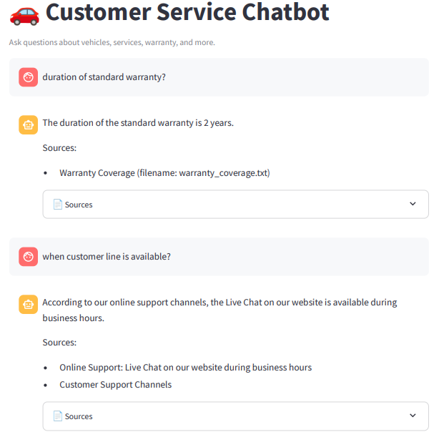
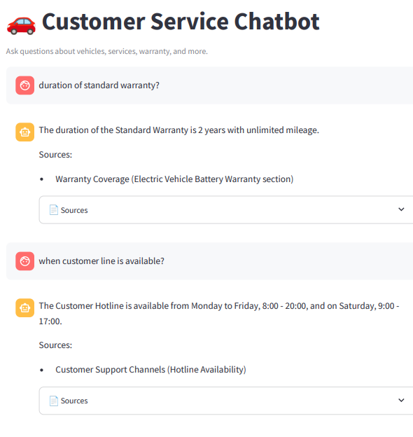
Document Ingestion
Optimizing Chunk Parameters: 25% Semantic Overlap
✅
✅
❌
✅
CHUNK_SIZE = 300
CHUNK_OVERLAP = 75
CHUNK_SIZE = 400
CHUNK_OVERLAP = 100
Notes:
Concurrency Bottleneck: High traffic causes “database is locked” errors due to the SQLite backend, which limits concurrent write access.
"Unlike Chroma, which is limited by the storage of a single machine, Weaviate allows us to link multiple servers together. If our knowledge base grows, we don't buy a bigger computer; we just plug in another small one."
Free & Open Source
No monthly “pod” costs (e.g., Pinecone).
Great for Prototyping
Fastest way to build a working demo.
Local Storage
All data stays on your machine for maximum privacy.
Concurrency Bottleneck
High concurrency can cause slower responses or “database is locked” errors.
Root cause: SQLite backend limits concurrent write access.
HNSW Indexing: Uses the Hierarchical Navigable Small World algorithm, which allows for lightning-fast similarity searches by keeping data in a specific "graph" structure.
Single-Node Design: Unlike enterprise systems, it runs on a single machine. It does not support native sharding (splitting data across multiple servers).
Category Advantages (Pros) Disadvantages (Cons)
Cost & Setup Free & Open Source: No monthly “pod” costs (e.g., Pinecone Pricing). Single-Node Architecture: Difficult to scale horizontally; if you outgrow one server, you must migrate.
Speed Great for Prototyping: Fastest way to build a working demo. Concurrency Bottleneck: High traffic causes “database is locked” errors due to the SQLite backend.
Performance Local Storage: All data stays on your machine for maximum privacy. Memory Dependency: Because of the HNSW algorithm, the entire index must fit in your System RAM.
Scalable Alternatives
Weaviate: Best for enterprise-grade scalability.
FAISS: Best for maximum raw search speed.
Memory Dependency
The search index must fit entirely in your system RAM. If your data grows too large for your computer's memory, performance will crash.

Slide 9
Document Ingestion
Optimizing Chunk Parameters: 15% Semantic Overlap
✅
✅
❌
✅
CHUNK_SIZE = 300
CHUNK_OVERLAP = 45
CHUNK_SIZE = 400
CHUNK_OVERLAP = 60
Notes:
Concurrency Bottleneck: High traffic causes “database is locked” errors due to the SQLite backend, which limits concurrent write access.
"Unlike Chroma, which is limited by the storage of a single machine, Weaviate allows us to link multiple servers together. If our knowledge base grows, we don't buy a bigger computer; we just plug in another small one."
Free & Open Source
No monthly “pod” costs (e.g., Pinecone).
Great for Prototyping
Fastest way to build a working demo.
Local Storage
All data stays on your machine for maximum privacy.
Concurrency Bottleneck
High concurrency can cause slower responses or “database is locked” errors.
Root cause: SQLite backend limits concurrent write access.
HNSW Indexing: Uses the Hierarchical Navigable Small World algorithm, which allows for lightning-fast similarity searches by keeping data in a specific "graph" structure.
Single-Node Design: Unlike enterprise systems, it runs on a single machine. It does not support native sharding (splitting data across multiple servers).
Category Advantages (Pros) Disadvantages (Cons)
Cost & Setup Free & Open Source: No monthly “pod” costs (e.g., Pinecone Pricing). Single-Node Architecture: Difficult to scale horizontally; if you outgrow one server, you must migrate.
Speed Great for Prototyping: Fastest way to build a working demo. Concurrency Bottleneck: High traffic causes “database is locked” errors due to the SQLite backend.
Performance Local Storage: All data stays on your machine for maximum privacy. Memory Dependency: Because of the HNSW algorithm, the entire index must fit in your System RAM.
Scalable Alternatives
Weaviate: Best for enterprise-grade scalability.
FAISS: Best for maximum raw search speed.
Memory Dependency
The search index must fit entirely in your system RAM. If your data grows too large for your computer's memory, performance will crash.

Slide 10
Embedding Creation & Vector Store Architecture
Vector Store Architecture
Category | Advantages (Pros) | Disadvantages (Cons)
Cost & Setup | Free & Open Source | Single-Node Architecture: Difficult to scale horizontally
Speed | Fast to Prototype | Concurrency Bottleneck: High traffic causes “database is locked” errors due to the SQLite backend
Performance | Local Storage | Memory Dependency: The entire index must fit in your system RAM (HNSW)
Scalable Alternatives
FAISS: Best for maximum raw search speed due to GPU support and advanced search algorithms, e.g., Inverted File (IVF).
Weaviate: Best for enterprise-grade scalability due to Horizontal Sharding, Hybrid Search and Smart Filtering support.
Notes:
Concurrency Bottleneck: High traffic causes “database is locked” errors due to the SQLite backend, which limits concurrent write access.
"Unlike Chroma, which is limited by the storage of a single machine, Weaviate allows us to link multiple servers together. If our knowledge base grows, we don't buy a bigger computer; we just plug in another small one."
Free & Open Source
No monthly “pod” costs (e.g., Pinecone).
Great for Prototyping
Fastest way to build a working demo.
Local Storage
All data stays on your machine for maximum privacy.
Concurrency Bottleneck
High concurrency can cause slower responses or “database is locked” errors.
Root cause: SQLite backend limits concurrent write access.
HNSW Indexing: Uses the Hierarchical Navigable Small World algorithm, which allows for lightning-fast similarity searches by keeping data in a specific "graph" structure.
Single-Node Design: Unlike enterprise systems, it runs on a single machine. It does not support native sharding (splitting data across multiple servers).
Category Advantages (Pros) Disadvantages (Cons)
Cost & Setup Free & Open Source: No monthly “pod” costs (e.g., Pinecone Pricing). Single-Node Architecture: Difficult to scale horizontally; if you outgrow one server, you must migrate.
Speed Great for Prototyping: Fastest way to build a working demo. Concurrency Bottleneck: High traffic causes “database is locked” errors due to the SQLite backend.
Performance Local Storage: All data stays on your machine for maximum privacy. Memory Dependency: Because of the HNSW algorithm, the entire index must fit in your System RAM.
Scalable Alternatives
Weaviate: Best for enterprise-grade scalability.
FAISS: Best for maximum raw search speed.
Memory Dependency
The search index must fit entirely in your system RAM. If your data grows too large for your computer's memory, performance will crash.

Slide 11
Part 2: RAG Pipeline

Slide 12
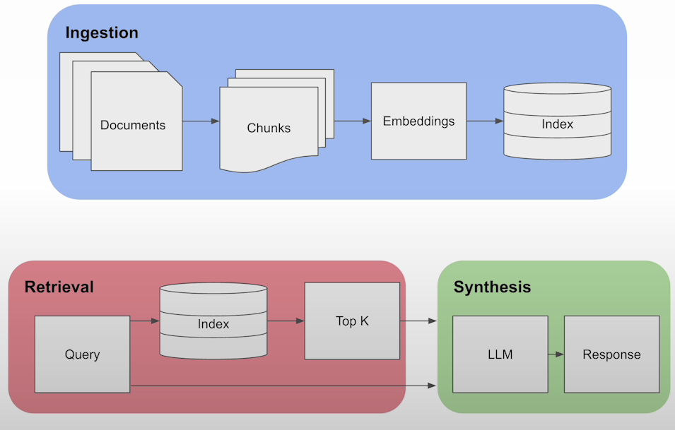
Part 2: RAG Pipeline
Overview
Figure 1: Basic RAG Pipeline

Slide 13
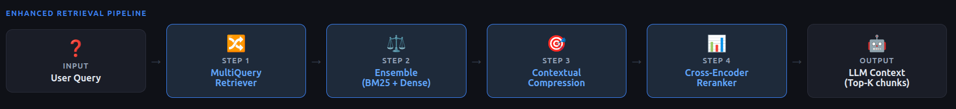
Part 2: RAG Pipeline
Multi-Stage Retrieval & Refinement
Query Expansion (Multi-Query): LLM generates three variations of the input to improve semantic coverage.
Ensemble Retrieval: Parallel search across Vector (Semantic) and BM25 (Keyword) stores, merged via Reciprocal Rank Fusion (RRF).
Contextual Compression: Post-processing to extract only the relevant snippets from the top chunks, reducing noise and token usage.
Re-Ranking (Cross-Encoder): High-precision scoring of query-document pairs to move the most relevant chunks to the top.

Slide 14
Part 2: RAG Pipeline
Enhanced Retrieval Pipeline
Technique | What it fixes
BM25 (keyword) | Embeddings miss exact keyword matches (model names)
EnsembleRetriever | Fuses keyword and semantic search chunks via Reciprocal Rank Fusion
MultiQueryRetriever | Rephrase the question 3 times
Contextual Compression + Reranker | Filter irrelevant sentences from retrieved chunks before sending to LLM
Table 1: Overview of the Retrieval Stage and implemented techniques being used.

Slide 15
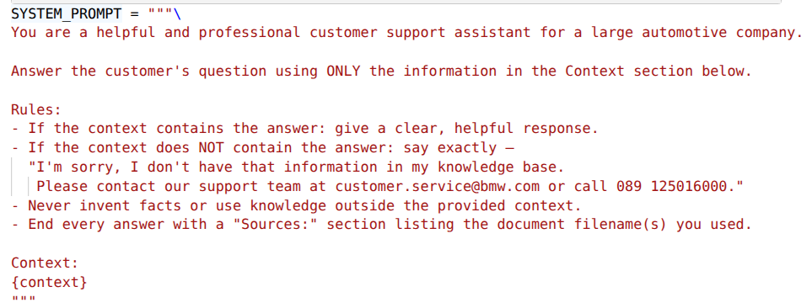
Part 2: RAG Pipeline
Response Generation
System Prompt:
Safe Fallback: Ensures the LLM does not hallucinate answers.
Authentic Contact Info: Provides the official email and customer service phone number of BMW.
Source Attachment: Attaches the document(s) used by the model.
PromptTemplate Usage: To generate responses.
Notes:
Concurrency Bottleneck: High traffic causes “database is locked” errors due to the SQLite backend, which limits concurrent write access.
"Unlike Chroma, which is limited by the storage of a single machine, Weaviate allows us to link multiple servers together. If our knowledge base grows, we don't buy a bigger computer; we just plug in another small one."
Free & Open Source
No monthly “pod” costs (e.g., Pinecone).
Great for Prototyping
Fastest way to build a working demo.
Local Storage
All data stays on your machine for maximum privacy.
Concurrency Bottleneck
High concurrency can cause slower responses or “database is locked” errors.
Root cause: SQLite backend limits concurrent write access.
HNSW Indexing: Uses the Hierarchical Navigable Small World algorithm, which allows for lightning-fast similarity searches by keeping data in a specific "graph" structure.
Single-Node Design: Unlike enterprise systems, it runs on a single machine. It does not support native sharding (splitting data across multiple servers).
Category Advantages (Pros) Disadvantages (Cons)
Cost & Setup Free & Open Source: No monthly “pod” costs (e.g., Pinecone Pricing). Single-Node Architecture: Difficult to scale horizontally; if you outgrow one server, you must migrate.
Speed Great for Prototyping: Fastest way to build a working demo. Concurrency Bottleneck: High traffic causes “database is locked” errors due to the SQLite backend.
Performance Local Storage: All data stays on your machine for maximum privacy. Memory Dependency: Because of the HNSW algorithm, the entire index must fit in your System RAM.
Scalable Alternatives
Weaviate: Best for enterprise-grade scalability.
FAISS: Best for maximum raw search speed.
Memory Dependency
The search index must fit entirely in your system RAM. If your data grows too large for your computer's memory, performance will crash.

Slide 16
Part 3: Demo in Action

Slide 17
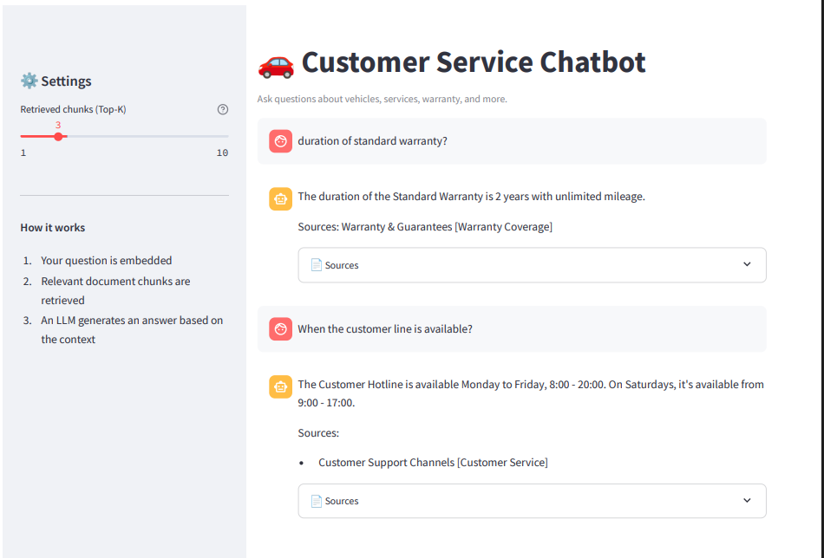
Part 3: Demo in Action
Notes:
“Let’s start with a brief overview of CLIP “
lets move on to the key idea
________________________________________________________
We believe CLIP’s text features are underused — and we aim to change that.”

Slide 18
Part 4: Tools & Evaluation

Slide 19
Part 4: Tools & Evaluation
How well does the chatbot perform?
Metric | Score | Status | Interpretation
Avg Faithfulness | 1.00 / 1.0 | ✅ Excellent | The LLM is strictly using the provided context and not hallucinating.
Avg Relevance | 1.00 / 1.0 | ✅ Excellent | The generated answers directly address the user's specific questions.
Avg Context Recall | 0.60 / 1.0 | ⚠️ Warning | The retriever is missing about 40% of the relevant information needed for a full answer.
Works well:
Perfect faithfulness and relevance across all 6 questions.
The system prompt, temperature 0, and reranker together prevent hallucinations and keep answers on-topic.
The LLM never invents facts or goes off-topic.
What to improve:
Context recall drops on multi-step answers (warranty, ordering).
The reference uses different phrasing than the retrieved chunks.
Next step: expand the eval set to 49 questions and tune chunk size.
Notes:
Concurrency Bottleneck: High traffic causes “database is locked” errors due to the SQLite backend, which limits concurrent write access.
"Unlike Chroma, which is limited by the storage of a single machine, Weaviate allows us to link multiple servers together. If our knowledge base grows, we don't buy a bigger computer; we just plug in another small one."
Free & Open Source
No monthly “pod” costs (e.g., Pinecone).
Great for Prototyping
Fastest way to build a working demo.
Local Storage
All data stays on your machine for maximum privacy.
Concurrency Bottleneck
High concurrency can cause slower responses or “database is locked” errors.
Root cause: SQLite backend limits concurrent write access.
HNSW Indexing: Uses the Hierarchical Navigable Small World algorithm, which allows for lightning-fast similarity searches by keeping data in a specific "graph" structure.
Single-Node Design: Unlike enterprise systems, it runs on a single machine. It does not support native sharding (splitting data across multiple servers).
Category Advantages (Pros) Disadvantages (Cons)
Cost & Setup Free & Open Source: No monthly “pod” costs (e.g., Pinecone Pricing). Single-Node Architecture: Difficult to scale horizontally; if you outgrow one server, you must migrate.
Speed Great for Prototyping: Fastest way to build a working demo. Concurrency Bottleneck: High traffic causes “database is locked” errors due to the SQLite backend.
Performance Local Storage: All data stays on your machine for maximum privacy. Memory Dependency: Because of the HNSW algorithm, the entire index must fit in your System RAM.
Scalable Alternatives
Weaviate: Best for enterprise-grade scalability.
FAISS: Best for maximum raw search speed.
Memory Dependency
The search index must fit entirely in your system RAM. If your data grows too large for your computer's memory, performance will crash.

Slide 20
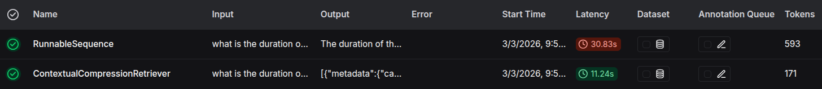
Part 4: Tools & Evaluation
LangChain & LangSmith
LangSmith is LangChain's observability platform. It's very useful for debugging why a particular answer was wrong.
What to improve: Latency.
Notes:
Concurrency Bottleneck: High traffic causes “database is locked” errors due to the SQLite backend, which limits concurrent write access.
"Unlike Chroma, which is limited by the storage of a single machine, Weaviate allows us to link multiple servers together. If our knowledge base grows, we don't buy a bigger computer; we just plug in another small one."
Free & Open Source
No monthly “pod” costs (e.g., Pinecone).
Great for Prototyping
Fastest way to build a working demo.
Local Storage
All data stays on your machine for maximum privacy.
Concurrency Bottleneck
High concurrency can cause slower responses or “database is locked” errors.
Root cause: SQLite backend limits concurrent write access.
HNSW Indexing: Uses the Hierarchical Navigable Small World algorithm, which allows for lightning-fast similarity searches by keeping data in a specific "graph" structure.
Single-Node Design: Unlike enterprise systems, it runs on a single machine. It does not support native sharding (splitting data across multiple servers).
Category Advantages (Pros) Disadvantages (Cons)
Cost & Setup Free & Open Source: No monthly “pod” costs (e.g., Pinecone Pricing). Single-Node Architecture: Difficult to scale horizontally; if you outgrow one server, you must migrate.
Speed Great for Prototyping: Fastest way to build a working demo. Concurrency Bottleneck: High traffic causes “database is locked” errors due to the SQLite backend.
Performance Local Storage: All data stays on your machine for maximum privacy. Memory Dependency: Because of the HNSW algorithm, the entire index must fit in your System RAM.
Scalable Alternatives
Weaviate: Best for enterprise-grade scalability.
FAISS: Best for maximum raw search speed.
Memory Dependency
The search index must fit entirely in your system RAM. If your data grows too large for your computer's memory, performance will crash.

Slide 21
Part5: Conclusion & Outlook

Slide 22
Conclusion & Outlook
Conclusion:
  We introduce RAGChatbot, a Q&A system built for fast prototyping using ChromaDB and Llama 3.2 3B.
  To improve retrieval, we use multiple retrievers with re-ranking.
  Optimal settings: 400 token chunk size with 60-token overlap (15%).
  Integrates LangSmith with LangChain for pipeline orchestration.
Notes:
Future Work: Enhancing Retrieval with LlamaIndex
Optimized Local RAG: Transition to LlamaIndex to leverage specialized indexing that speeds up local document processing.
Improved Accuracy: Use advanced "Small-to-Big" retrieval to provide the chatbot with better context, reducing hallucinations in customer support.
Expanded Data Support: Easily integrate local PDFs, FAQs, and Wiki pages using LlamaHub connectors.
Hybrid Approach: Use LlamaIndex for the Knowledge Engine while keeping LangChain for Conversation Logic.
"To scale this local chatbot, I plan to integrate LlamaIndex. It will act as a high-performance 'search engine' for our local documents, making customer responses faster and more precise than standard RAG."

Slide 23
Conclusion & Outlook
Future Work:
  Improve scalability by migrating to different vector stores, e.g., FAISS, WEVIATE.
  Semantic Routing: The system "routes" the question based on its meaning/complexity.
  Analyze and improve the embeddings space using PCA, investigate how the query and similar documents are located in the high-dimensional space.
  Optimized RAG: Implement LlamaIndex to accelerate local document processing and reduce latency in response generation.
  Recursive Querying: Enable the bot to follow internal document references (e.g., "See Section 2.1") automatically for more complete answers.
  Implement advanced techniques of Prompt Engineering:
    Prompt Sanitization: cleans user inputs from malicious attacks.
  Metadata filtering: remove irrelevant documents.
  Improve chunking strategy
  Create a Docker image and deploy it to production.
Notes:
Future Work: Enhancing Retrieval with LlamaIndex
Optimized Local RAG: Transition to LlamaIndex to leverage specialized indexing that speeds up local document processing.
Improved Accuracy: Use advanced "Small-to-Big" retrieval to provide the chatbot with better context, reducing hallucinations in customer support.
Expanded Data Support: Easily integrate local PDFs, FAQs, and Wiki pages using LlamaHub connectors.
Hybrid Approach: Use LlamaIndex for the Knowledge Engine while keeping LangChain for Conversation Logic.
"To scale this local chatbot, I plan to integrate LlamaIndex. It will act as a high-performance 'search engine' for our local documents, making customer responses faster and more precise than standard RAG."

Slide 24
Thank you for your attention!

